Slide 1

Introduction to Power BI
BY Prof Deep Bhatt

Slide 2

Getting Know What is Power BI
The company defines Power BI as a collection of software services, apps, and connectors that work together to turn your unrelated sources of data into coherent, visually immersive, and interactive insights
The BI stands for “business intelligence,” and the tool gives non-technical users all the resources they need to aggregate, visualize, analyze, and share data. The business world considers Power BI one of the best drag-and-drop tools available in the industry today.
Let's See What's Power BI

Slide 3

What is Power BI Potential?
Power BI facilitates intelligent decision making, reducing the likelihood of failure, and mitigating inherent risks..
Data security is a big concern today, and Power BI lets users track and control data usage, granting access only to those who should have it.
Power BI is scalable, so it can fit any organization and handle changes in size, either a rapid business expansion or an unexpected downsizing.

Slide 4









Who all Use Power BI?
Administrator
Accountant
Designer
Programmers

Slide 5





ADVANTAGES OF POWER BI.
Access over 70 data connectors
Easy To Use
Interactive Dashboards
Data Sharing & Collabrations
Cost Effective

Slide 6




Job Opportunities that Power BI Generates
Data Analyst
Business Analyst
Software Engineer
Data Scientist

Slide 7
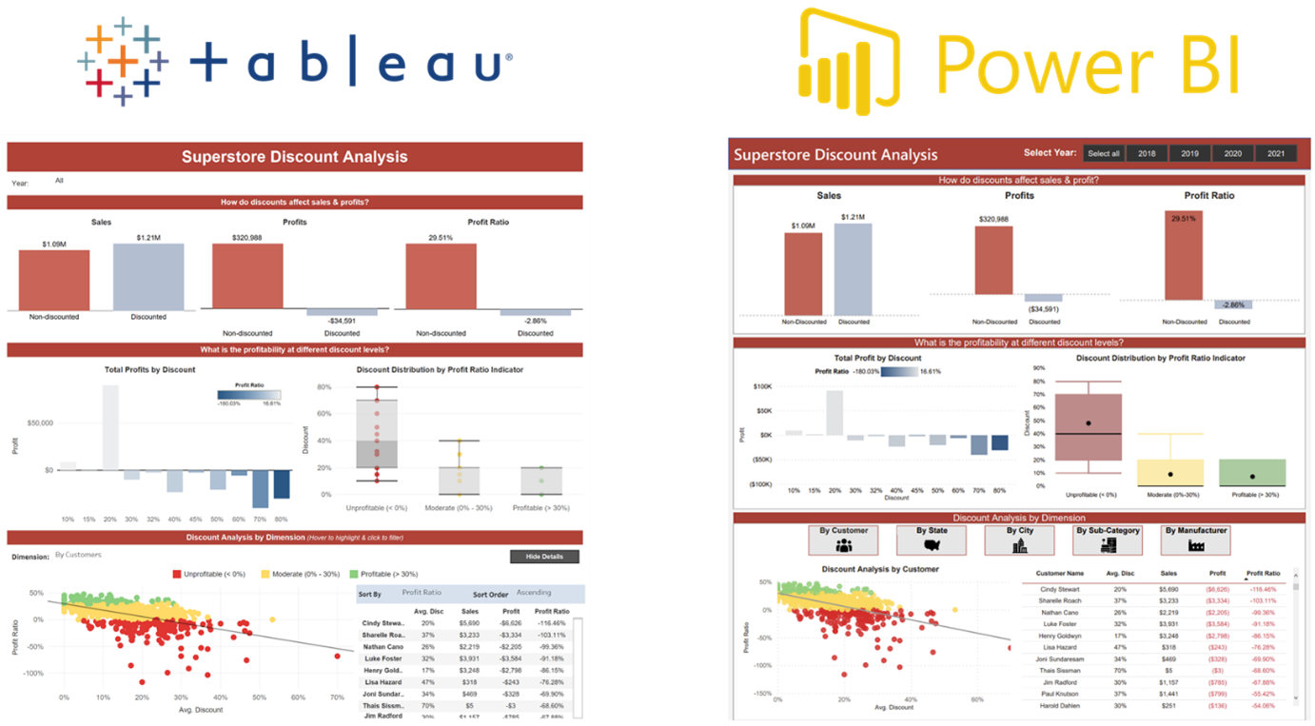
Power BI Vs Tableau

Slide 8
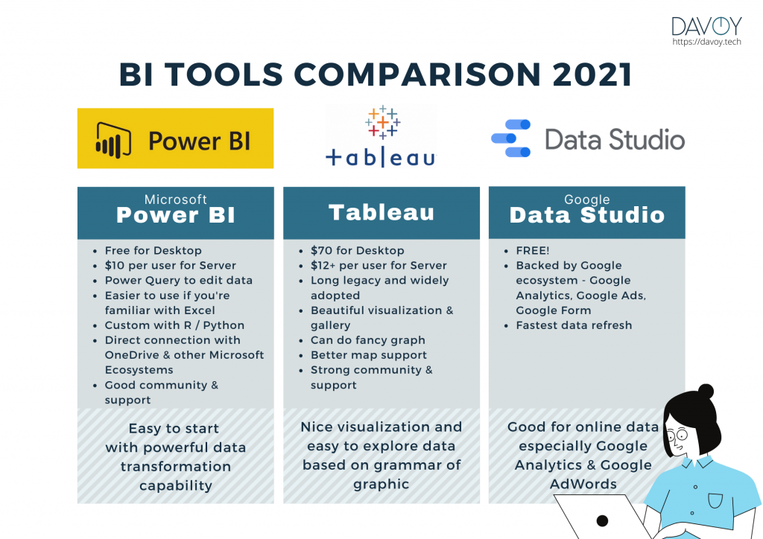

Power BI Vs Tableau

Slide 9
Power BI Advantages over Tableau.
Price: Power BI provides all features and services for $10 per user per month. With Power BI Pro, the user can access the full range of Power BI components and Microsoft services such as Cortana to trigger voice queries.
MSFT Integration: Power BI can be easily integrated with Azure/O365 and anything else created by Microsoft, which is a huge advantage for users as all operations run smoothly on Microsoft.
Ease of use: For beginners, Power BI provides an intuitive learning curve, and the interface resembles that of MS Excel, making it easy to navigate. In Power BI, we can take advantage of the DAX query language and run queries on datasets in natural language.
ETL/Discovery suite: Compared to Tableau, Power BI has a robust set of tools for implementing ETL functions. Data preparation accounts for more than 90% of all reporting requirements, and Power BI can directly create these data marts for reporting without the use of third-party software.

Slide 10


Limitation Of Powe BI
Relationships between tables: Power BI is prone to problems when processing data that has complex relationships with tables. In many cases, you must carefully create data models with unique fields just to join tables.
User Interface: Power BI has a cluttered interface with many icon options that prevent reports and dashboards from being displayed. In addition, the label in Power BI has limited functionality.
iOS Compatibility: Power BI does not have a compatible option for Mac desktop users. Power BI cannot be installed directly on iOS; a virtual machine must be installed to run Power BI Desktop.
Limited Excel integration: Excel integration is a significant benefit of Power BI, but only data up to 150,000 rows can be downloaded, which can be very limiting sometimes.

Slide 11
Some Famous Questions for PoweBI
Is Power BI or Tableau easier to learn?
-For new users and non-data analysts, Power BI is simpler to use. Tableau is recognized to have a more demanding learning curve; it is more prevalent among seasoned data analysts.
3. What pays more, Tableau or Power BI?
Ans For Exp for Power BI – 9 to 15L
For Tableau Exp professionals get - 8L – 12L
3.What is accepted more by Organization
- Power BI from last 3 Years has been accepted by 90% of the organizations worldwide
What is Weightage between Power BI & Tableau
-Power BI holds 60% weightage & Tableau hold 40%

Slide 12
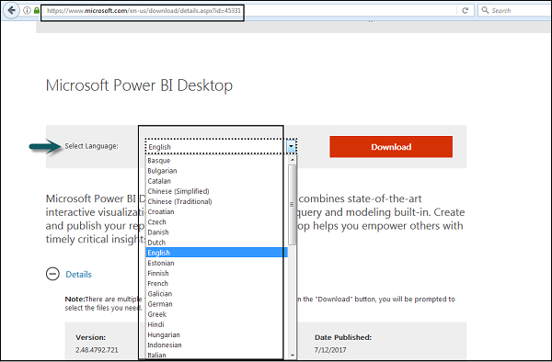
Installing Power BI
Step 1
https://powerbi.microsoft.com/en-us/downloads/

Slide 13
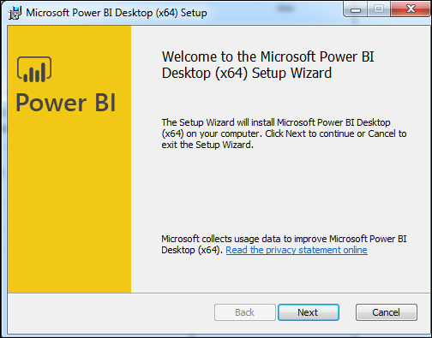
Installing Power BI
Step 2

Slide 14
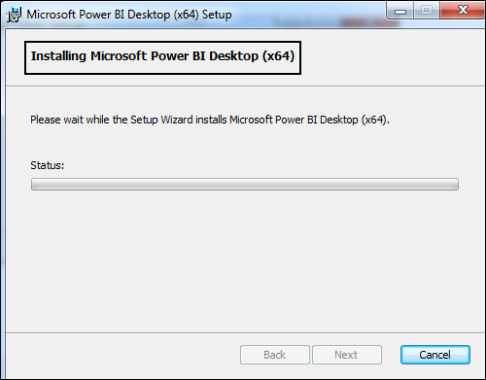
Installing Power BI
Step 3

Slide 15
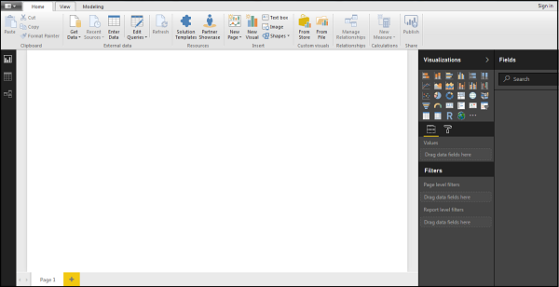
Installing Power BI
Step 4

